Slide 1
Applied Data Science Capstone – Final Project

Slide 2
Contents
Introduction
Source Data
Data Processing
Visualization
Analysis
Conclusion

Slide 3
Introduction – Business insight
Reasons of Starting a Gym or fitness center business in Hong Kong (h.k.):
Generates income through receiving membership fees & selling fitness equipment
Makes people healthier → transform their lives
Notes:
Consider talking about:
Fitness
Cardiovascular system
Immune system
Cancer
Neurobiological
Sleep
Libido

Slide 4
Introduction - topic
Investigate which neighborhood in Hong kong would be the best location to open a GYM business, with the following criteria:
Neighborhoods that do not provide similar sport services
Inexpensive neighborhoods
Notes:
Consider talking about:
Skeletal muscle
Other peripheral organs
Central nervous system

Slide 5
Source DATA – districts in h.k.
Content:
Investigate which neighborhood in h.k. would be the best location to open such a business
Format: csv
Notes:
Consider talking about:
Social and cultural variation

Slide 6
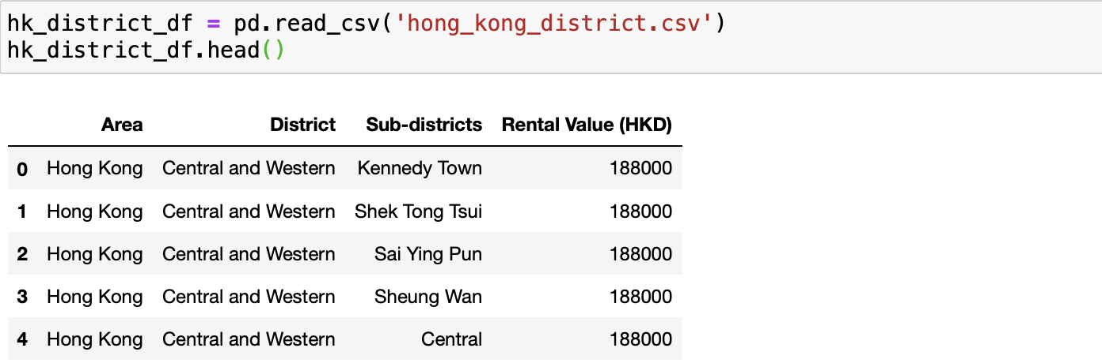
Source DATA – districts in H.K.
Notes:
Consider talking about:
Social and cultural variation

Slide 7
Source DATA – neighborhood in h.k.
Content:
By using function Nominatim, operated by Open street map (OSM) to:
- Receive a specific location as input
- Return the location’s latitude & longitude as output
Format: json
Notes:
Consider talking about:
Social and cultural variation

Slide 8
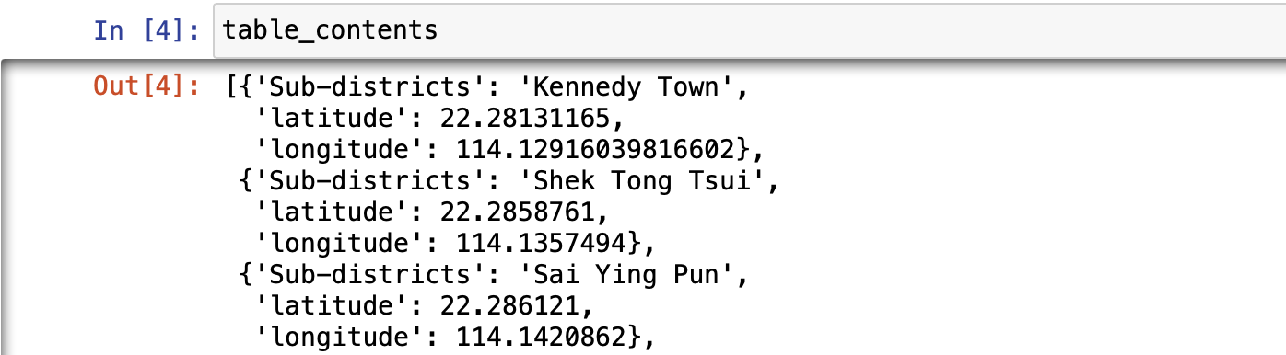
Source DATA – neighborhood in h.k.
Notes:
Consider talking about:
Social and cultural variation

Slide 9
Source DATA – venues in h.k.
Content:
By using foursquare to:
- Receive each neighborhood’s Latitude & Longitude
- Return nearby venues’ latitude & longitude as output
Format: json
Notes:
Consider talking about:
Social and cultural variation

Slide 10
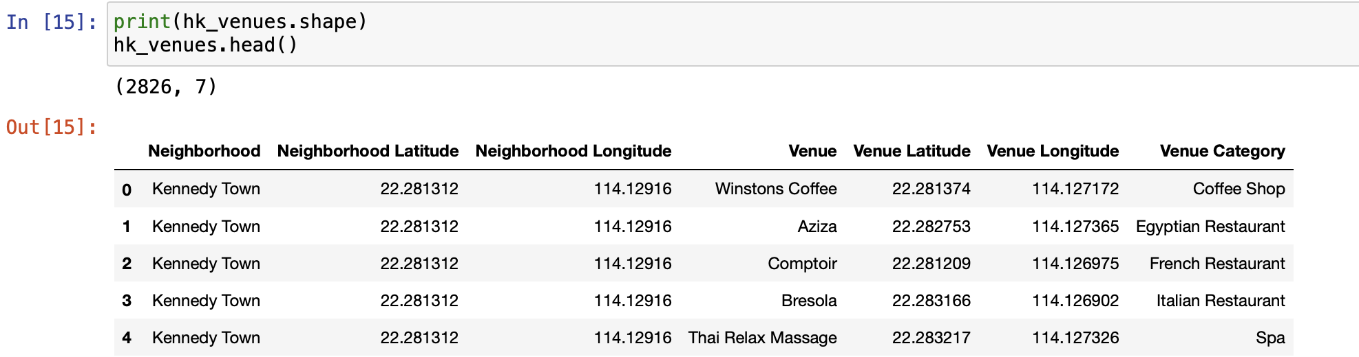
Source DATA – venues in h.k.
Notes:
Consider talking about:
Social and cultural variation

Slide 11
Processing Data – one hot encoding
Use one hot encoding to:
convert venue names & venue categories into 0/1
Group rows by neighborhood
Take the average frequency of occurrence of each venue category
Notes:
Consider talking about:
Social and cultural variation

Slide 12
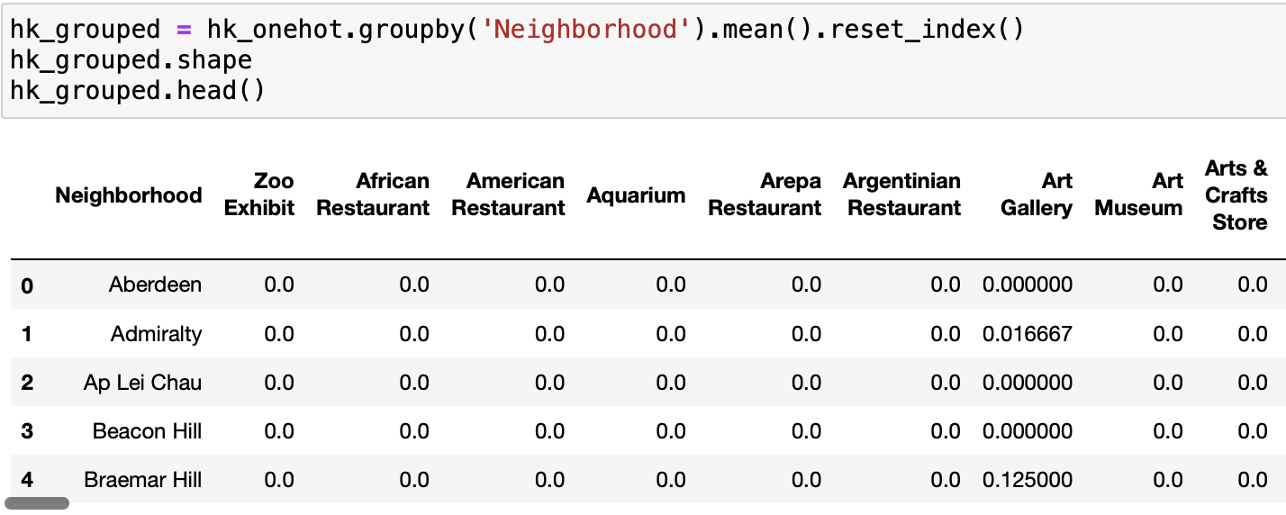
Processing Data – one hot encoding
Notes:
Consider talking about:
Social and cultural variation

Slide 13
Processing Data – k-means clustering
Use k-means clustering to find the most relevant cluster of neighborhood for further analysis. Steps include:
Group the top 10 most common venues in each neighborhood
Use silhouette score to Calculate the most optimal k-value
Cluster the dataset using k-means
Notes:
Consider talking about:
Social and cultural variation

Slide 14
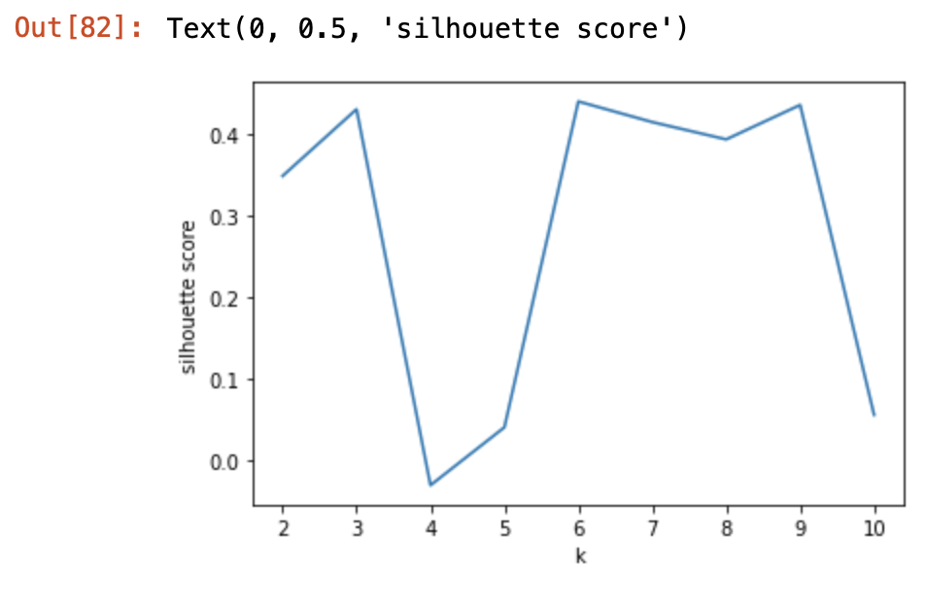
Processing Data – silhouette score
The k-value is optimal at k=9, whereas the silhouette score is the highest
Notes:
Consider talking about:
Social and cultural variation

Slide 15
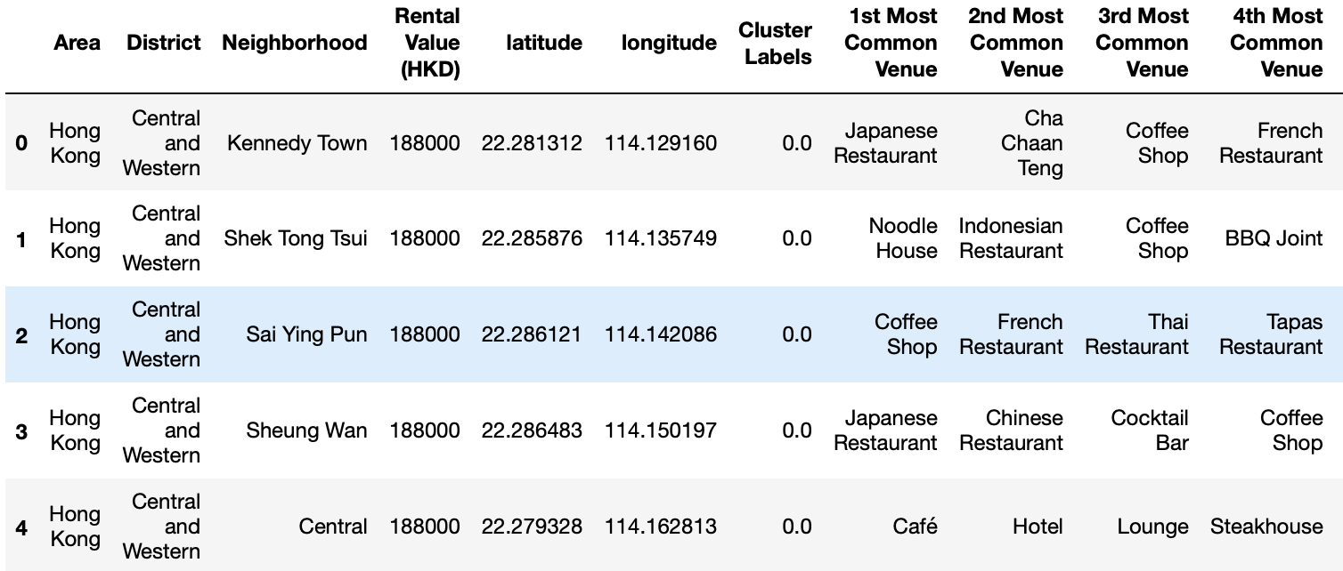
Processing Data – k-means clustering
The data are clustered into 9 groups and are labeled from 0 to 8.
Notes:
Consider talking about:
Social and cultural variation

Slide 16
Visualization – neighborhood in H.k.
Visualize all the neighborhood (sub-districts) located in h.k. using folium package
Notes:
Consider talking about:
Social and cultural variation

Slide 17
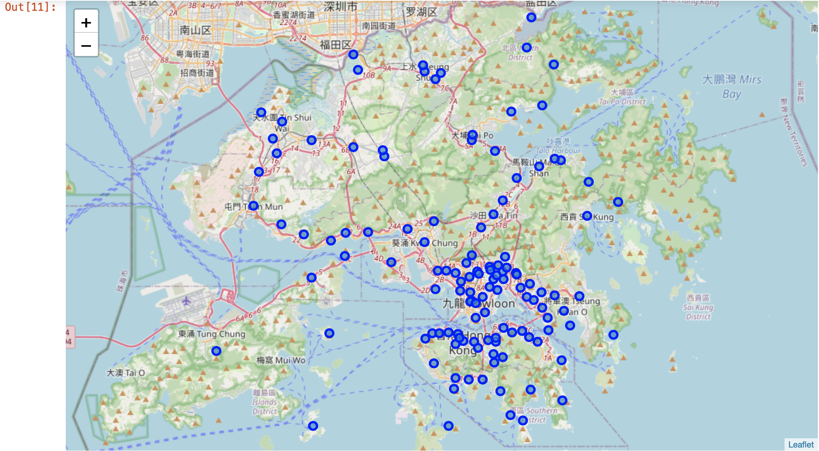

Slide 18
Visualization – clustered neighborhood in H.k.
Visualize all the neighborhood (sub-districts) located in h.k., by clustering the venues into 9 groups
Notes:
Consider talking about:
Social and cultural variation

Slide 19
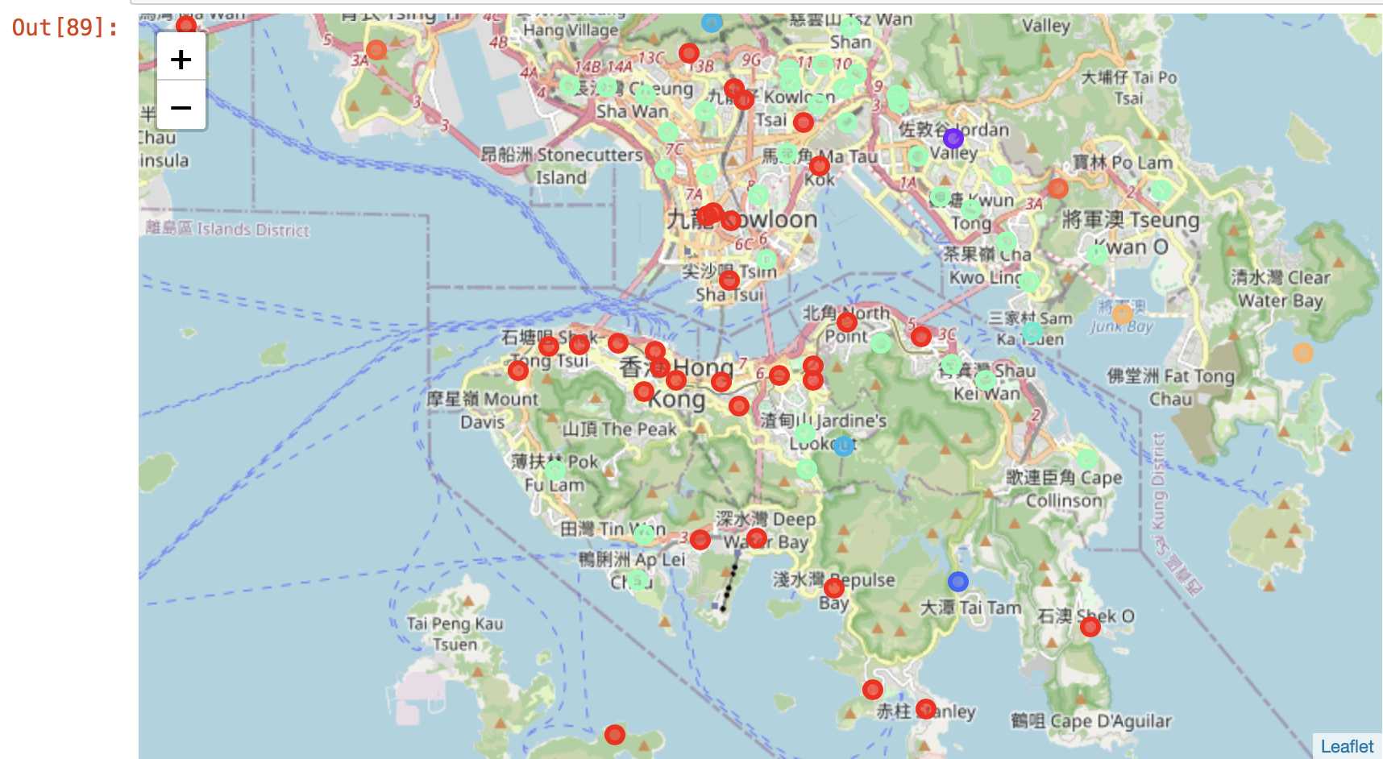

Slide 20
Analysis – choosing the target cluster
Venues are grouped mainly into two clusters, so we will choose the most suitable cluster
For cluster #0, miscellaneous venues such as gym pool, trail
For cluster #5, venues shown are focused on shopping mall, restaurants, transportation facilities, which seems to be a more accessible and convenient place, so will be beneficial for opening a gym business there
Target cluster – cluster #5
Notes:
Consider talking about:
Social and cultural variation

Slide 21
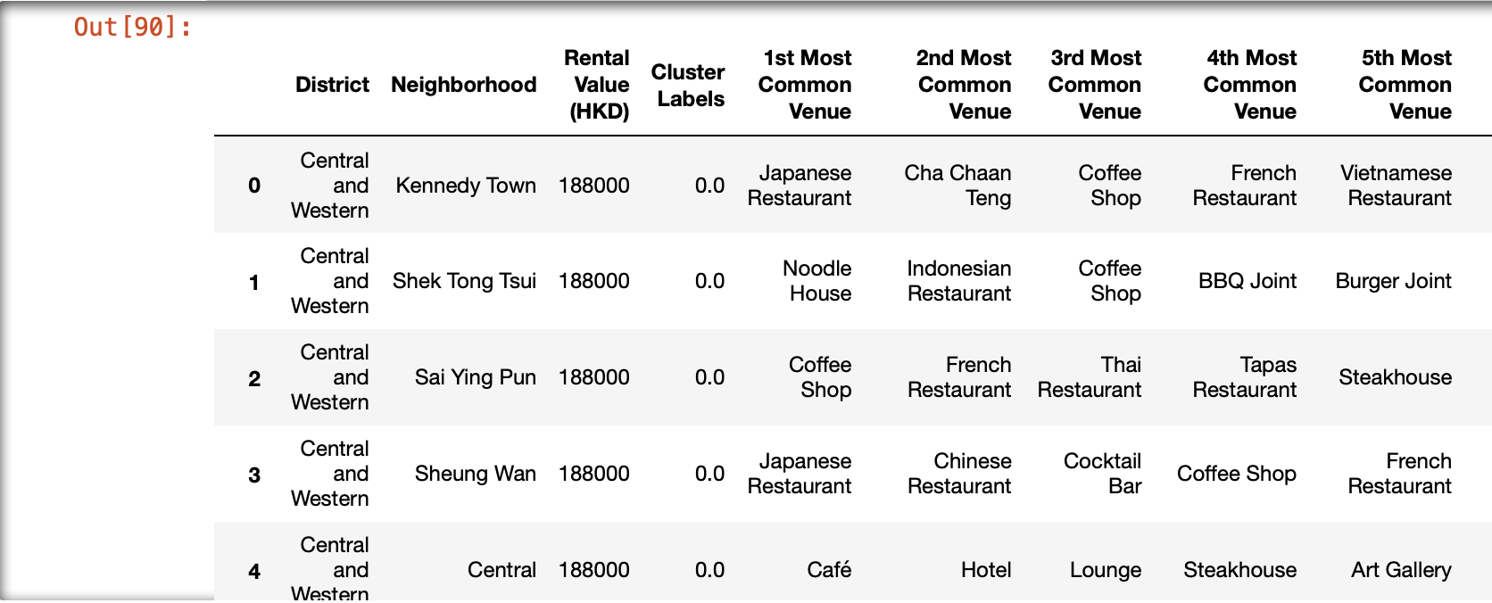

Slide 22
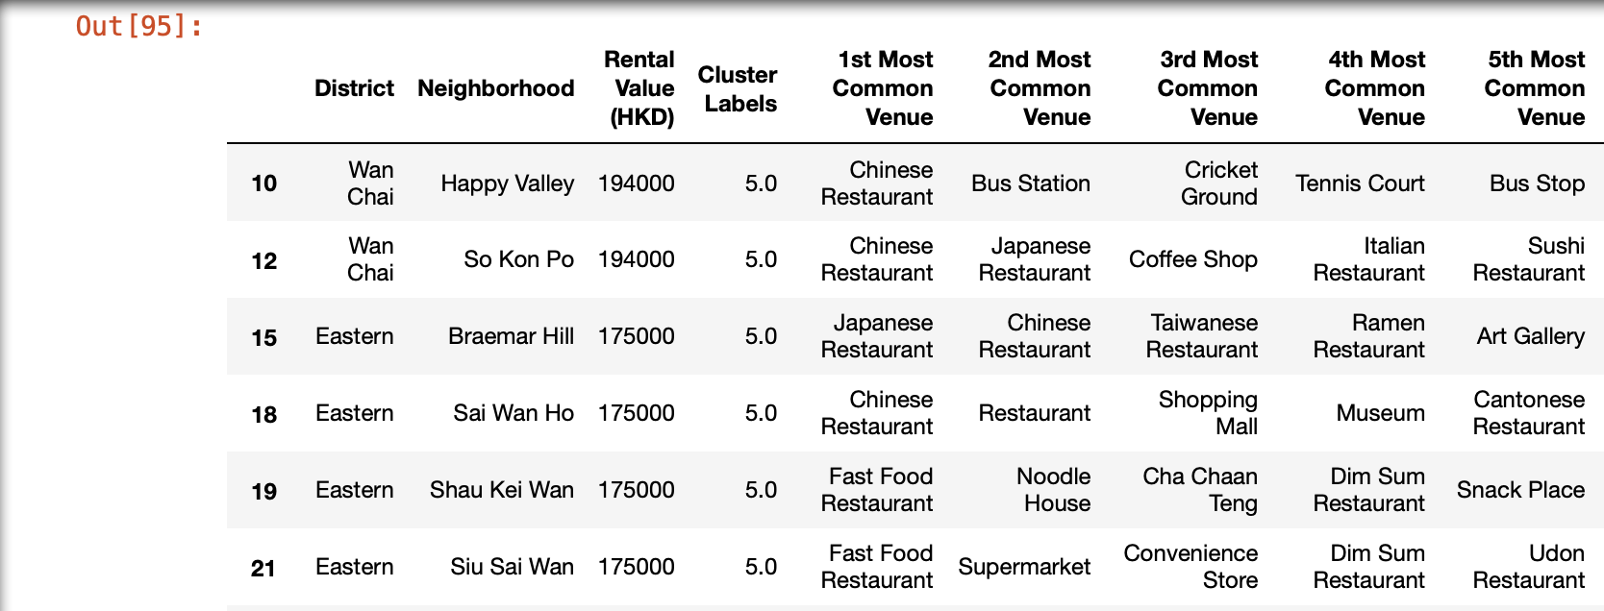

Slide 23
Analysis – Find the optimal neighborhoods
Filtering out neighborhoods that already have venues providing gym/ATHLETICS & SPORTS services
Notes:
Consider talking about:
Social and cultural variation

Slide 24
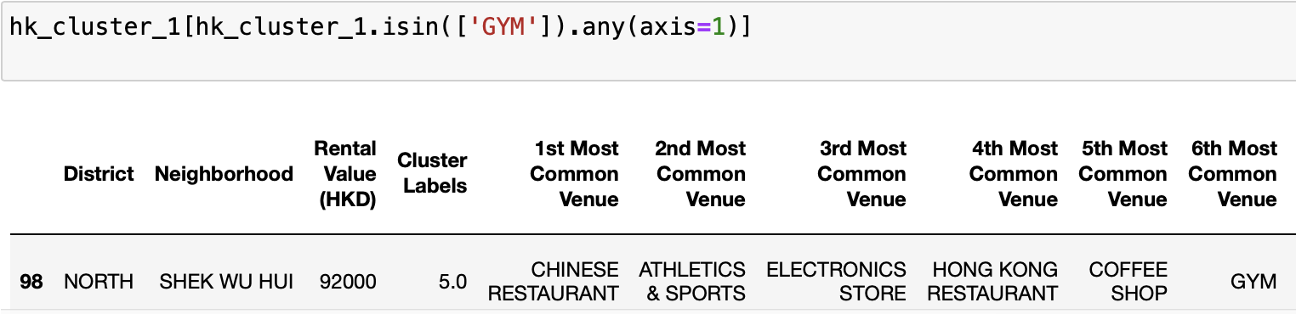
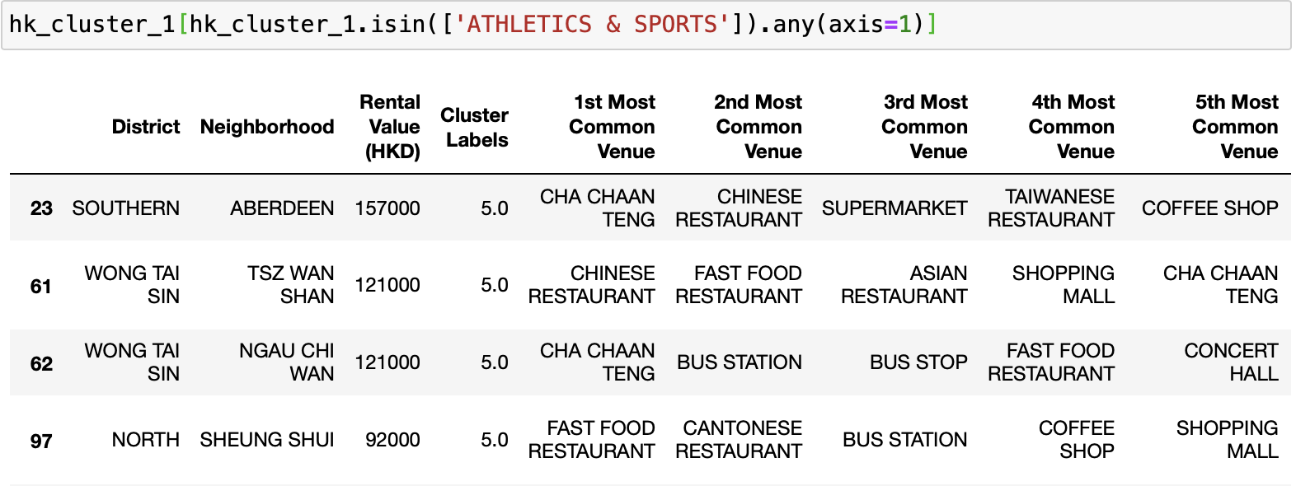

Slide 25
Analysis – Find the optimal neighborhoods
Filtering our neighborhoods that have hotels/pier/zoo, which will have low demand for gym/fitness equipment/services
Notes:
Consider talking about:
Social and cultural variation

Slide 26
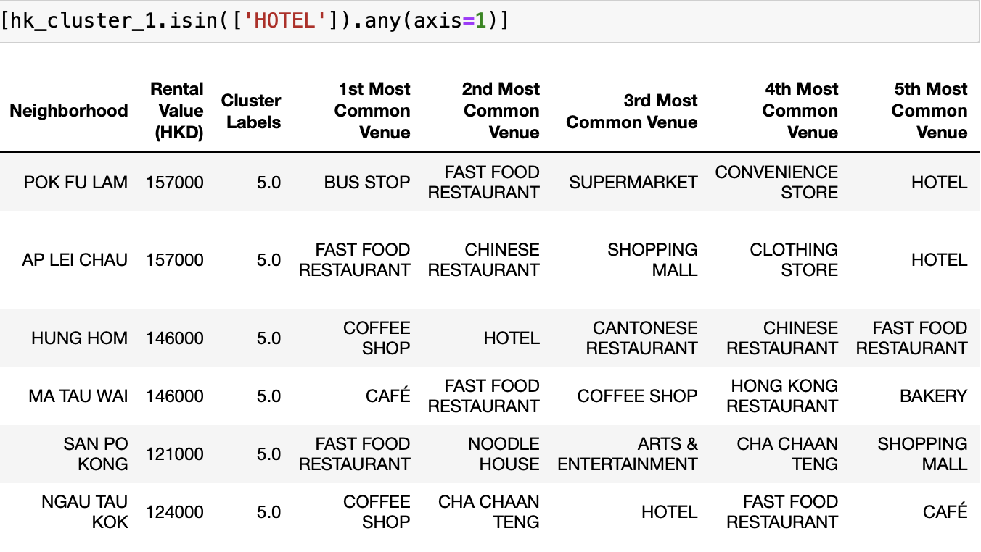

Slide 27
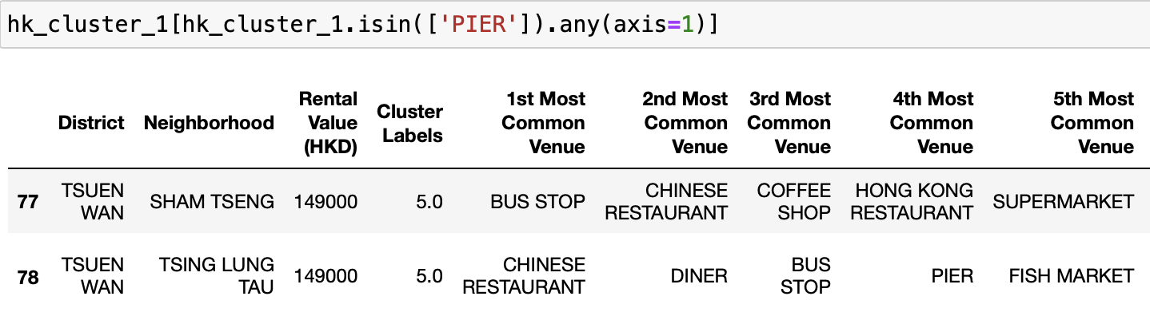
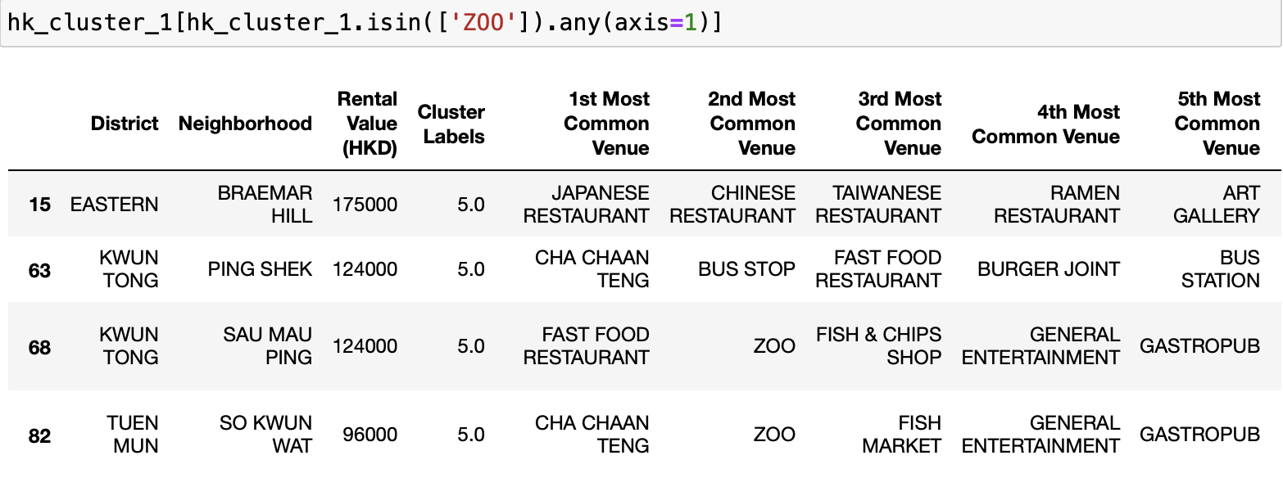

Slide 28
Analysis – Find the optimal neighborhoods
Filtering our neighborhoods that with average (or even below average) rental price (for 1000 square feet, in HKD), which would be affordable for running a small gym business
Notes:
Consider talking about:
Social and cultural variation

Slide 29
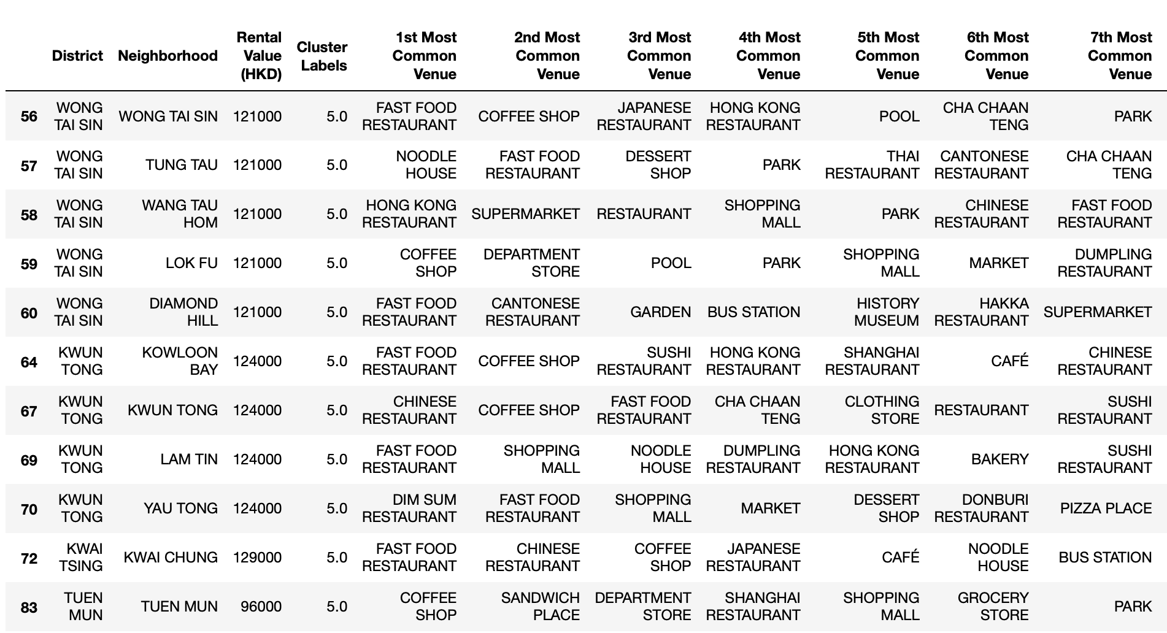

Slide 30
Analysis – Find the optimal neighborhoods
H.k. neighborhoods are narrowed down from 122 to 17
Group the sub-categories shown in top 10 most common venues list in these 17 neighborhoods into 5 groups:
Dining
Event
Shopping
Transport
others
Notes:
Consider talking about:
Social and cultural variation

Slide 31
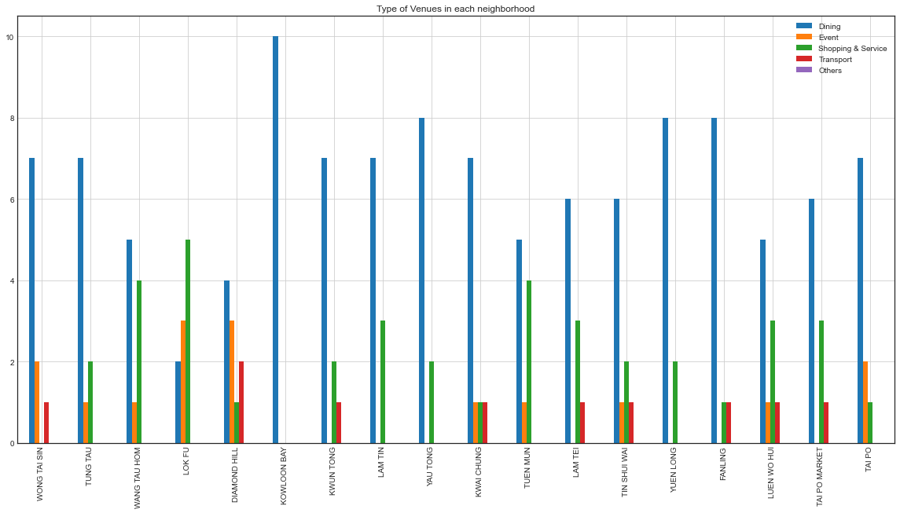

Slide 32
Conclusion
Open a gym business in a neighborhood that:
Does not have competitors proving similar sport/gym services
Has Higher demand of sport/gym services
is inexpensive
Is economically diverse
Neighborhoods “luen wo hui”, “tin shui Wai”, “Kwai Chung”, “Diamond hill” are optimal for running a gym business
Notes:
Consider talking about:
Social and cultural variation

